Slide 1


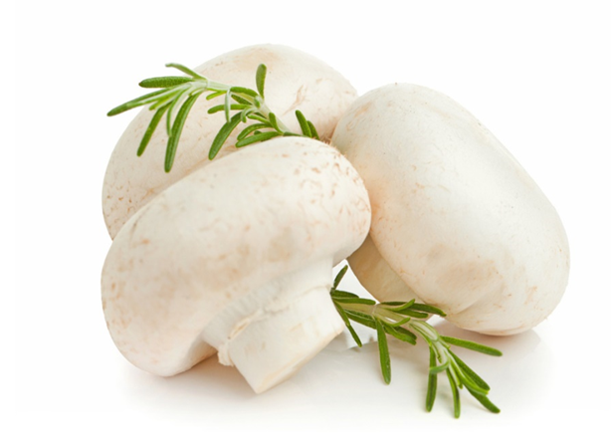
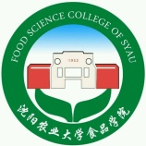
Changes in color, antioxidant, and free radical scavenging enzyme activity of mushrooms under high oxygen modified atmospheres
By：Ying Limei
Supervisor：Sun Bingxin
FOOD SCIENCE COLLEGE OF SYAU
食品学院

Slide 2
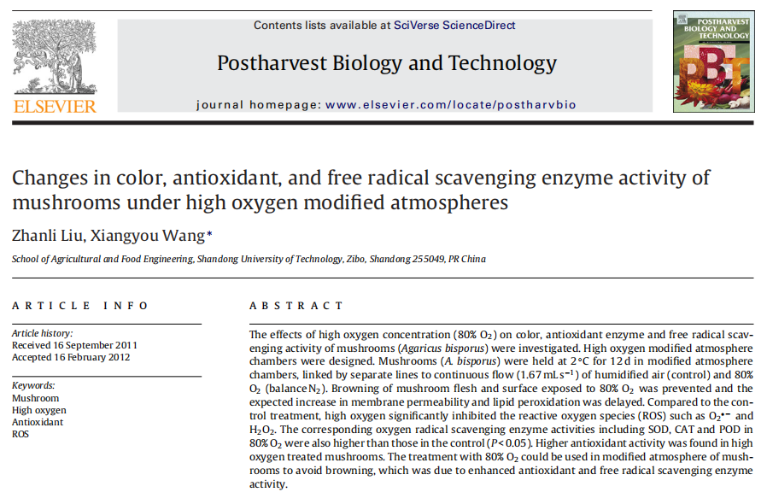
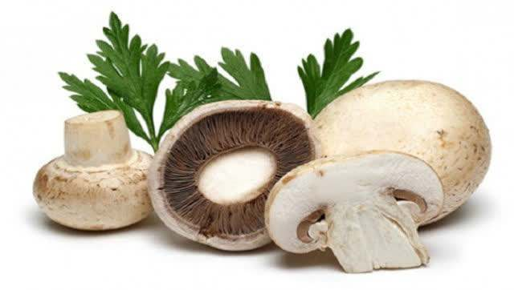
Postharvest Biology and Technonlogy
IF：4.43
Keywords：
Mushroom
High oxygen
Antioxidant(抗氧化剂)
ROS（活性氧）
FOOD SCIENCE COLLEGE OF SYAU
食品学院

Slide 3
Contents
01
Introduction
02
Materials and methods
03
Results and discussion
04
Conclusion
FOOD SCIENCE COLLEGE OF SYAU
食品学院

Slide 4
01
Introduction
FOOD SCIENCE COLLEGE OF SYAU
食品学院

Slide 5

The commercial value of mushroom decreases within 2–3 d Mainly because they have no cuticle to protect them from physical damage or microbial attack and water loss . Browning is the major factor limiting shelf life of mushroom.Mushroom slices packaged under 80%O₂/20% N₂ and stored at 8◦C had more than 12-d shelf life(Day,2001).But elevated O₂ concentrations can cause the production of reactive oxygen species (ROS).
(主要是因为它们没有角质层保护它们免受物理伤害或微生物攻击和水分流失)
但是升高的O₂浓度会导致产生活性氧（ROS）
FOOD SCIENCE COLLEGE OF SYAU
食品学院

Slide 6
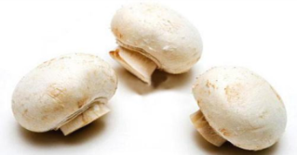

Enzymatic ROS scavenging(清除) systems include superoxide dismutase (SOD)(超氧化物歧化酶), peroxidase (POD)(过氧化物酶) and catalase (CAT)(过氧化氢酶) .
The objective of our research was to determine the effects of the application of a high oxygen atmosphere of 80% O₂, balance N₂ on color, antioxidant enzyme and free radical scavenging activity of mushrooms that might be involved in browning control.
（研究的目的是应用80% O₂的高氧气调，平衡N₂对可能参与褐变控制的蘑菇的颜色、抗氧化酶和自由基清除活性的影响）
FOOD SCIENCE COLLEGE OF SYAU
食品学院

Slide 7
02
Materials and methods
FOOD SCIENCE COLLEGE OF SYAU
食品学院

Slide 8
（1）. High oxygen modified atmosphere chambers
The dynamic（动态） control system maintains the concentration（浓度） of oxygen and carbon dioxide, and determines nitrogen flow, temperature and humidity（湿度） of each chamber in real-time(实时).
Material :Mushrooms with cap size of 40–50 mm.
80% O₂(balanced with N₂).
Chambers temperature：2℃.
Relative humidity : 95%.
There were three chambers at high oxygen and three at standard air conditions as controls.
FOOD SCIENCE COLLEGE OF SYAU
食品学院

Slide 9
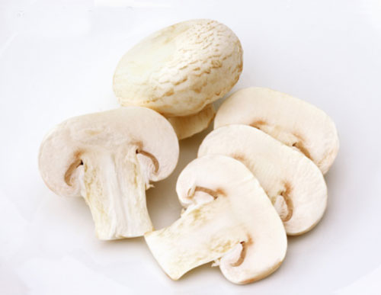
membrane permeability（膜透性）
Color
Superoxide radical scavenging activity
（超氧化物自由基清除活性）
lipid peroxidation
（脂质过氧化）
DPPH radical scavenging activity
measurement standard
superoxide radical (O₂•−)
（超氧自由基）
total phenolic
H₂O₂ content
Enzyme assays
（POD、SOD、 CAT）
FOOD SCIENCE COLLEGE OF SYAU
食品学院

Slide 10
03
Results and discussion
FOOD SCIENCE COLLEGE OF SYAU
食品学院

Slide 11

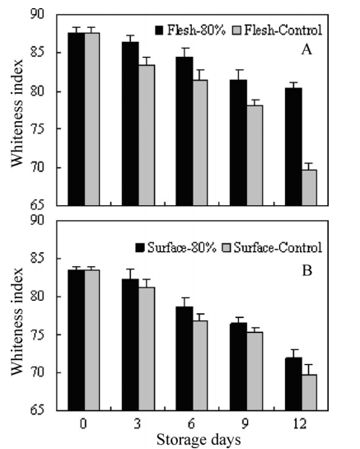
(1).Color
The whiteness index of mushroom flesh and surface decreased rapidly with storage time. Browning of mushrooms appeared after 3 d of storage and became serious after 9 d under air treatment. However, browning was found in mushrooms under high 80% O₂on day 9.
The mushrooms kept in air had a lower whiteness index, while high oxygen significantly delayed the decrease of the whiteness index.The results showed that high oxygen concentration was effective at inhibiting discoloration of mushrooms.
80.41
69.67
71.94
69.65
蘑菇肉（A）和表面（B）在80%氧气和空气中2℃贮藏时的白度指数。
FOOD SCIENCE COLLEGE OF SYAU
食品学院

Slide 12

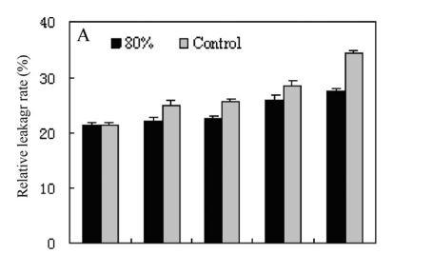

(2).Membrane permeability and lipid peroxidation
27.5%
Relative leakage rate is generally considered an indirect measure of cell membrane damage. In general, relative leakage rate in mushrooms increased with the storage.
Membrane stability（膜稳定性） is potentially a major factor of controlling the browning.
34.3%
21.4%
在2℃贮藏期间，在80%氧气和空气条件下的相对泄漏率（A）
FOOD SCIENCE COLLEGE OF SYAU
食品学院

Slide 13
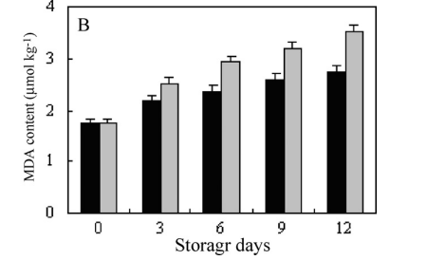


3.52
2.75
Marked increase in MDA content of mushrooms stored in air was found.The results indicated that high oxygen treatment could prevent the existence of mushroom oxidative injury（氧化损伤） to some degree.In the study, the decrease of relative leakage rate was correlated with the loss of membrane integrity（完整性）,which could be partly due to lipid peroxidation.
1.75
在2℃贮藏期间，在80%氧气和空气条件下的丙二醛含量（B）。
FOOD SCIENCE COLLEGE OF SYAU
食品学院

Slide 14
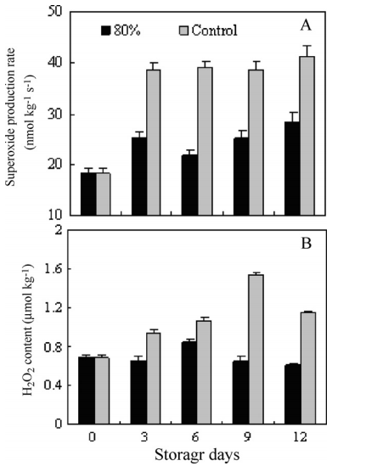

(3).Superoxide production rate and H₂O₂content
Reactive oxygen species (ROS) such as O₂•−（超氧阴离子）and H₂O₂have a role in lipid peroxidation（脂质过氧化）, membrane damage（膜损伤） and consequently in senescence（衰老）.
The overproduction of ROS is an intrinsic feature of senescence and fruit ripening .The accumulation of ROS is one of the processes that contribute to loss of membrane integrity（膜完整性） and membrane-bound enzyme activities （膜结合酶活性）.
23.7%
在2℃下储存期间，在80%氧气和空气条件下，O₂•—产生率（A）和H₂O₂含量（B）
FOOD SCIENCE COLLEGE OF SYAU
食品学院

Slide 15
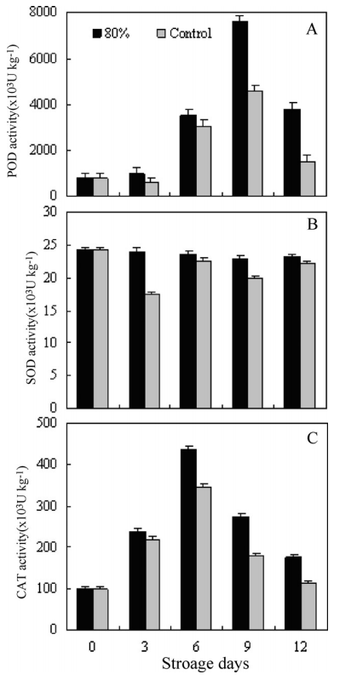

(4).Oxygen radical scavenging enzyme activities
SOD,CAT and POD are important active free-radical scavenging enzymes .
High levels of antioxidant enzymes are involved（参与） in alleviating（减轻） oxidative damage（氧化损伤） and delaying the senescence process . In this work, the increase of POD, SOD and CAT activity has been found in mushrooms under high oxygen. Thus, the decrease of SOD, CAT and POD may contribute to the development of browning in mushrooms. The effectiveness of high oxygen in delaying the occurrence of browning may result from delaying the reduction of antioxidant enzymes（延迟了抗氧化酶的还原） during the storage.
FOOD SCIENCE COLLEGE OF SYAU
食品学院

Slide 16
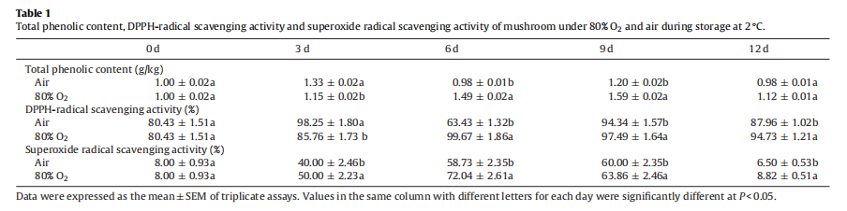
(5).Antioxidant activity
最大积累
High oxygen induced（诱导） a higher production of total phenolic and non-enzymatic antioxidant activity compared to the control.Antioxidant activity of fruits and vegetables is known to depend on a wide number of compounds（化合物）.In our study, the increase in antioxidant activity was probably due to the synthesis of phenolic compounds（酚类化合物的合成）, which may be related to induced stress metabolism（诱导的应急代谢）.
FOOD SCIENCE COLLEGE OF SYAU
食品学院

Slide 17
04
Conclusion
FOOD SCIENCE COLLEGE OF SYAU
食品学院

Slide 18

①
Postharvest metabolism of mushrooms was deeply modified by the application of high oxygen, which inhibited browning and delayed ripening. Mushrooms exposed to high oxygen concentration (80% O₂) were shown to have a higher whiteness index, and a lower increase in relative electrolyte leakage rate, lipid peroxidation, and ROS (O₂•−and H₂O₂) production indicating lower membrane damage.
利用高氧处理对蘑菇采后代谢进行了深度调控，抑制了蘑菇采后褐变和延迟成熟。暴露于高氧浓度（80% O₂）的蘑菇具有更高的白度指数，相对电解质渗漏率、脂质过氧化和ROS（O₂ -OH和H₂O₂）的生成较低，表明膜损伤较低。
FOOD SCIENCE COLLEGE OF SYAU
FOOD SCIENCE COLLEGE OF SYAU
食品学院
食品学院

Slide 19

②
Higher activities of SOD, POD and CAT and higher non-enzymatic antioxidant activities in mushrooms under high oxygen corresponded to low levels of ROS (H2O2and O2•−) accumulation, lipid peroxidation and relative electrolyte leakage rate. These effects were evidently responsible for reduced browning in mushroom flesh and surface during storage.
高氧条件下蘑菇SOD、POD、CAT活性较高，非酶促抗氧化活性较高，与低活性氧自由基积累、脂质过氧化和电解质外渗率有关。这些效应对蘑菇贮藏过程中果肉和表面褐变的减少有明显的作用。
FOOD SCIENCE COLLEGE OF SYAU
食品学院

Slide 20
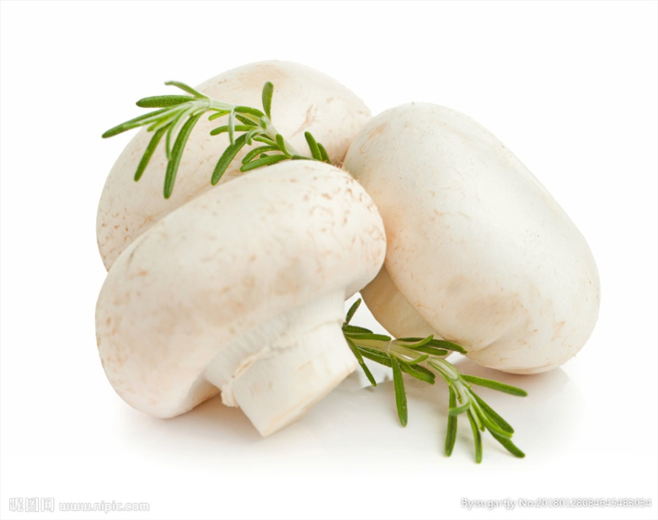
THANK YOU !
FOOD SCIENCE COLLEGE OF SYAU
食品学院

